Slide 1

Department of Scientific and Industrial Research Smart Management of Street lights for Energy Conservation
Team Leader : Ishwarya S
Technology Bucket : Miscellaneous
College Code : 3122

Slide 2
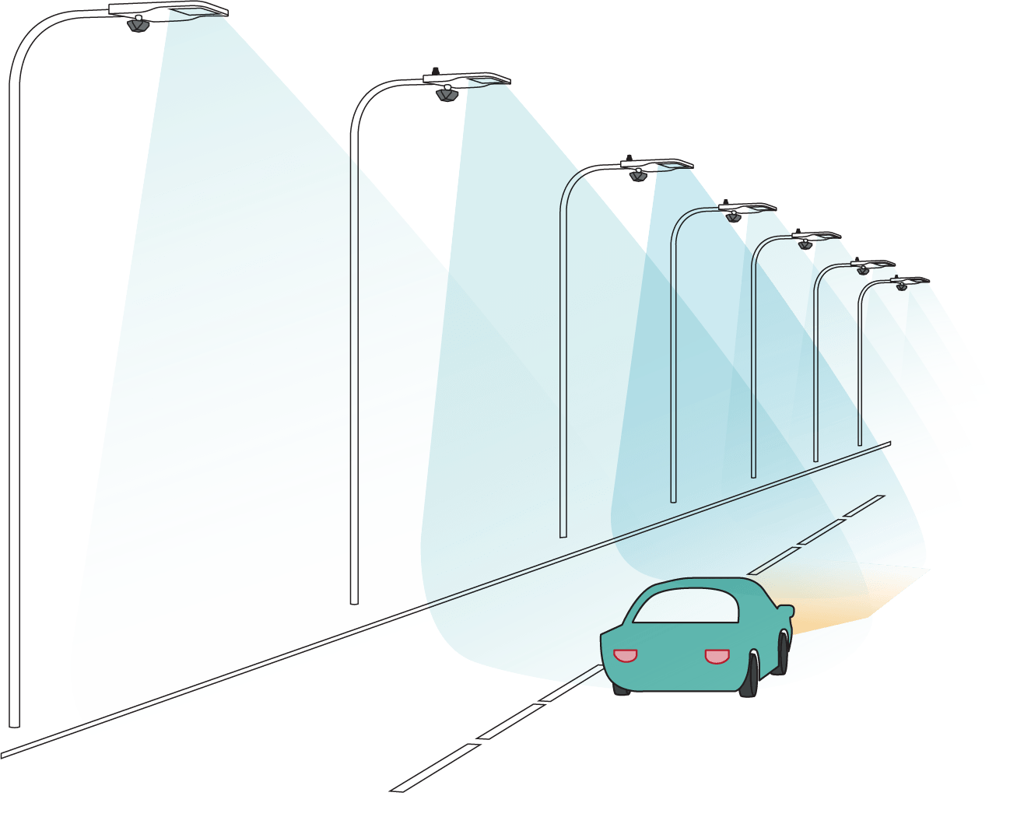
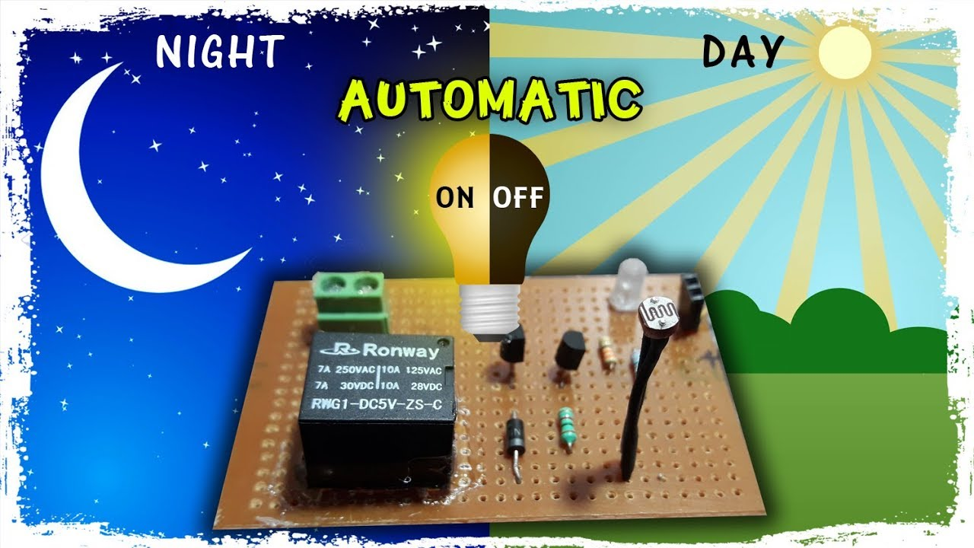
OBJECTIVES
1. To sense whether it is 2. To sense the motion
a day(6 A.M. – 6 P.M.) or of vehicles or pedestrian
night (6 P.M. -6 A.M.). in order to switch ON the
If it is day then the street nearby street lights.
lights are turned OFF
automatically .

Slide 3
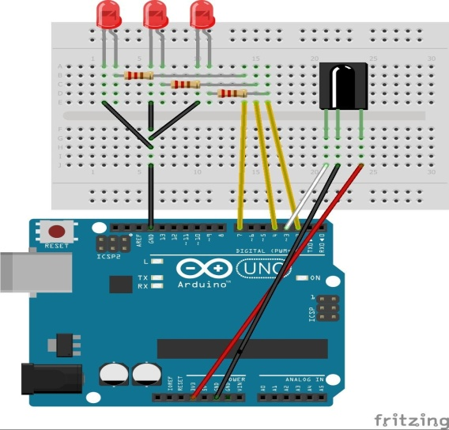
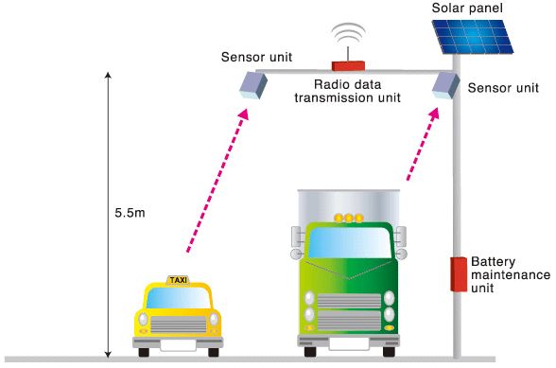
Our Idea!!!
1. LDR(Light Dependent 2. Motion Sensors(PIR 3. Arduino Uno
Resister) and IR sensor)
It allows the arduino PIR(Passive Infrared Based on the response
Uno to work only during Sensor) detects the motion from the motion sensors
night. So that the energy is of pedestrian . this device controls the
conserved during day time. IR(Infrared Sensor) detects working of street lights. the motion of vehicles.
Both the sensor sends the response to arduino Uno if they detects.

Slide 4
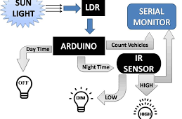
HOW IT WORKS

Slide 5
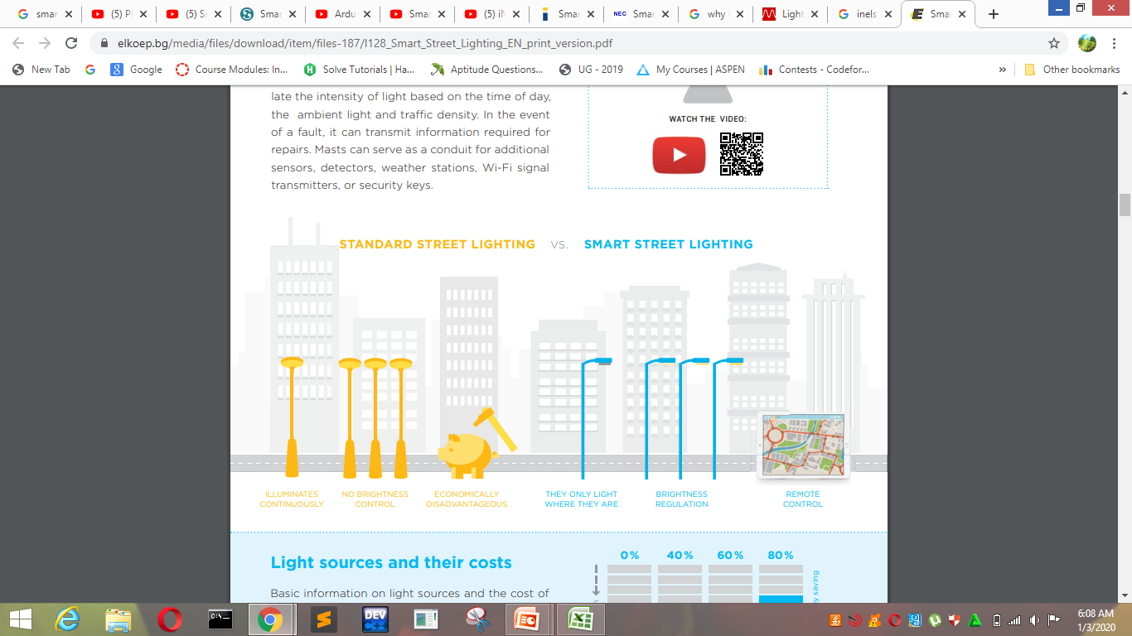
BENEFITS OF SMART STREET LIGHT

